Slide 1
Video Objects Tracking

Slide 2

The system
Assuming linear motion (constant velocity)
$\dot{x}=v$
$\dot{v}=0$
Notes:
Post 1: why ekf? The difference between linear and nonlinear.
What’s the punch?
None of the following systems could be developed: ..
Missile guidance, satellite navigation, autonomous driving, and much more could not have been developed without the support of extended Kalman filter estimation.
While the Kalman filter excels in linear systems, the EKF boldly extends its prowess to tackle the complexities of nonlinear systems, making it a dynamic force in modern estimation algorithms

Slide 3


Kalman process
Predict equations
$x=x+A⋅x⋅dt$
$P=F⋅P⋅F^{T}+Q_{k}$
$A=\left[\begin{matrix}0 & 0 & v_{x} & 0 \\ 0 & 0 & 0 & v_{y} \\ 0 & 0 & 0 & 0 \\ 0 & 0 & 0 & 0\end{matrix}\right]$
$F=I+A⋅dt$
$diag\left(Q\right)=\left[\begin{matrix}φ_{v} & φ_{v} & φ_{v} & φ_{v}\end{matrix}\right]$
$Q_{k}=Q⋅dt$
State
$X=\left[\begin{matrix}x & y & v_{x} & v_{y}\end{matrix}\right]$
$x, y$ position
$v_{x}, v_{y}$ velocity
Dynamics
$\dot{x}=v_{x}$
$\dot{y}=v_{y}$
${\dot{v}}_{x}=0$
${\dot{v}}_{y}=0$
$X_{0}={\left[\begin{matrix}x_{0} & y_{0} & v_{x_{0}} & v_{y_{0}}\end{matrix}\right]}^{T}$
$diag(P_{0})=\left[\begin{matrix}σ_{k}^{2} & σ_{k}^{2} & {v_{x}}_{err}^{2} & {v_{y}}_{err}^{2}\end{matrix}\right]$
Noise
Velocity uncertainty $σ_{v}=φ_{v}$
Notes:
The nonlinear part of the filter is manifested in the dynamic equations. These include the height velocity derivative which when expressed in terms of the ballistic coefficient $β$ is a nonlinear function of the height position $z$, the height velocity $v_{z}$, and the ballistic coefficient $β$ itself.
When the process noise matrix $Q$ is time-varying, you can provide the predict function with it at each call.

Slide 4


Kalman measure
Update equations
$k={P⋅H^{T}⋅\left(H⋅P⋅H^{T}+R_{k}\right)}^{−1}$
$x=x+k⋅(Z−H⋅x)$
$P=\left(I−k⋅H\right)⋅P$
$H=\left[\begin{matrix}1 & 0 & 0 & 0 \\ 0 & 0 & 1 & 0\end{matrix}\right]$
$R_{k}=\left[\begin{matrix}σ_{k}^{2} & 0 \\ 0 & σ_{k}^{2}\end{matrix}\right]$
Sensor
YOLOv3
Objects detection model
$Z=\left[\begin{matrix}x & y\end{matrix}\right]$
Noise
Measurement variance $σ_{k}^{2}$
Rate
$\frac{1}{30}msec$
Notes:
The nonlinearity may be manifested in different ways.
The system equations and the measure equations must be linearized even for the case of the extended Kalman filter, for the calculations of P and k. but as opposed to the regular Kalman filter, they are not linearized once about an equilibrium state, but rather they are linearized at each step about the estimated state.
In fact not always both the process equations and the measure equations are both nonlinear, and there may be mixed situations, i.e. either the process equations nonlinear or the measure equations nonlinear. But if both the process equations are linear and the measure equations are linear, then the selection in extended klaman filter is basically a missunderstandning, and the effort to calculate the linearized matrices at each step is total useless.
transition matrix F and the measure must be linearized for the calculation of P at the predict stage.
If the system equations are nonlinear, then the transition matrix F is linearized about the current estimated step at each step.
But

Slide 5

V

Slide 6
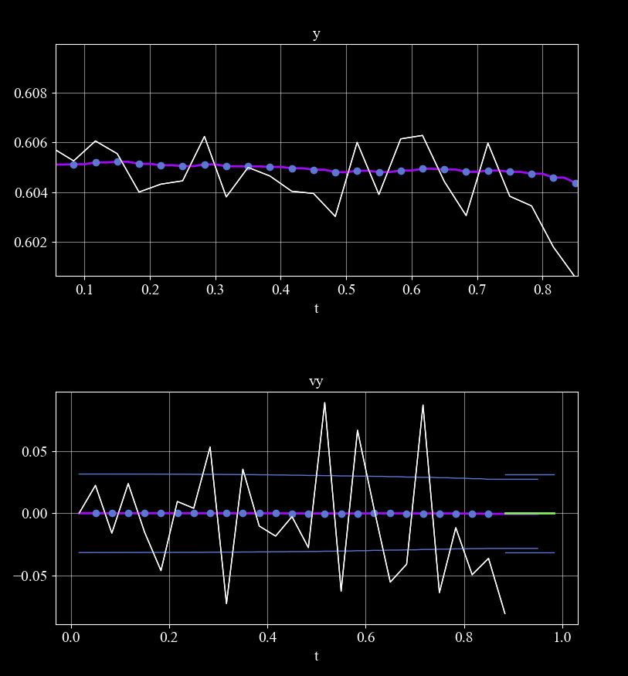
This can use as representative for the detector noise.
It seems like for 1sigma the noise is about .002.
As the initial position is determined by the detector input This can use also for initial error (P0).
True velocity is calculated by simple derivative of the sensor input.

Slide 7


Vehicle
$x_{0}=0, y_{0}=0.6$
$v_{x_{0}}=1, v_{y_{0}}=0$
$X_{0}=\left[\begin{matrix}pt_{x} & pt_{y} & 1 & 0\end{matrix}\right]$
$diag\left(P_{0}\right)=\left[\begin{matrix}σ_{d}^{2} & σ_{d}^{2} & {0.6}^{2} & {0.6}^{2}\end{matrix}\right]$
$σ_{d}=0.$002: 1 sigma detector noise
$diag\left(Q\right)=[\begin{matrix}q_{x} & q_{x} & q_{v} & q_{v}\end{matrix}]$
$q_{v}≫q_{x}$
$diag\left(R\right)=\left[\begin{matrix}σ_{k}^{2} & σ_{k}^{2}\end{matrix}\right]$
We need a small neural netwotk to identify the set of parameters for the init of the kalman filter.

Slide 8
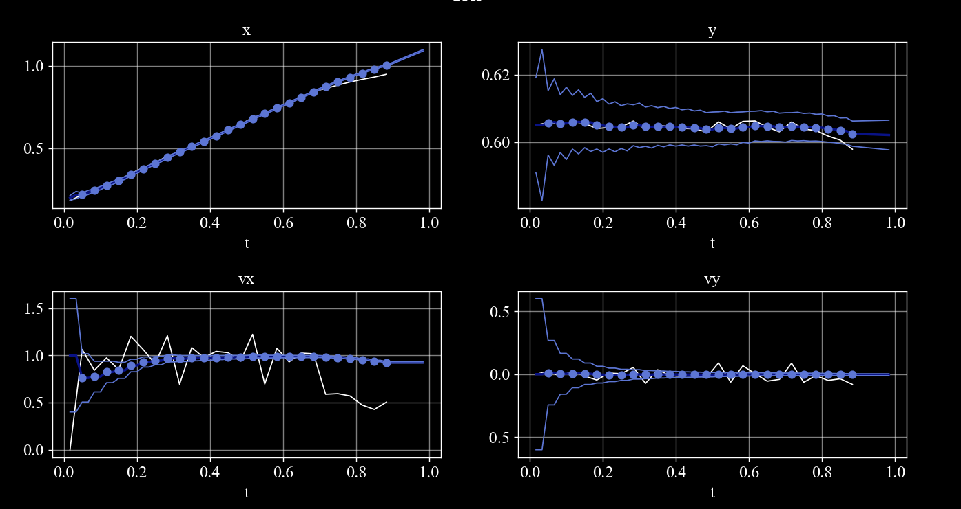
P 0.0001, 0.0001, 0.36, 0.36, x0= ptx, pty, 1, 0
Q 0.0, 0.0, 0.0, 0.0, R 0.0001, 0.0001,

Slide 9
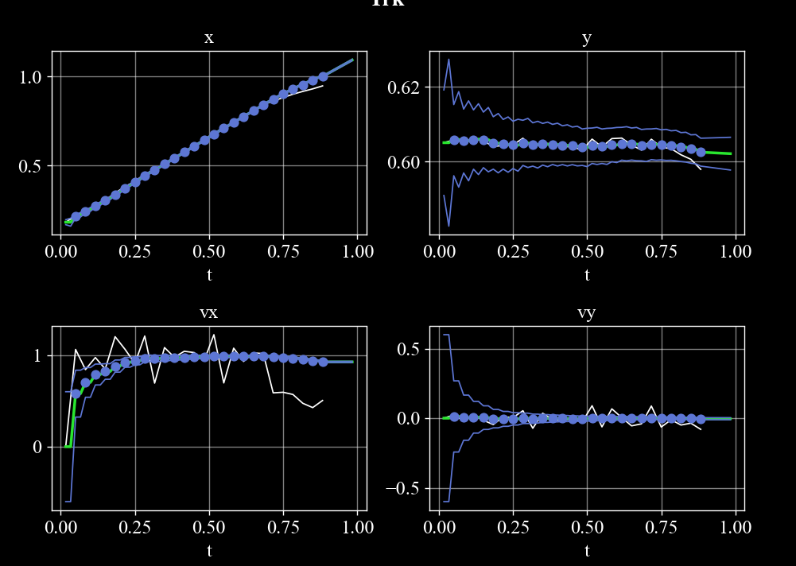
P 0.0001, 0.0001, 0.36, 0.36, x0= ptx, pty, 0, 0
Q 0.0, 0.0, 0.0, 0.0, R 0.0001, 0.0001,

Slide 10
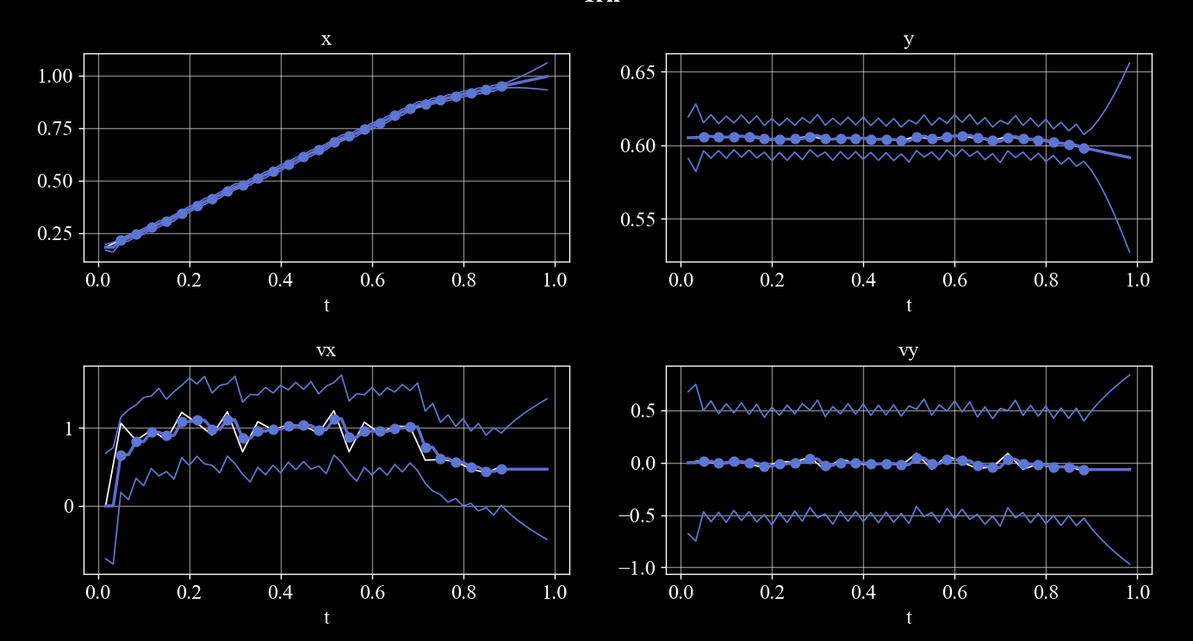
P 0.0001, 0.0001, 0.36, 0.36, x0= ptx, pty, 0, 0
Q 0.0, 0.0, 0.1, 0.1, R 0.0001, 0.0001,

Slide 11
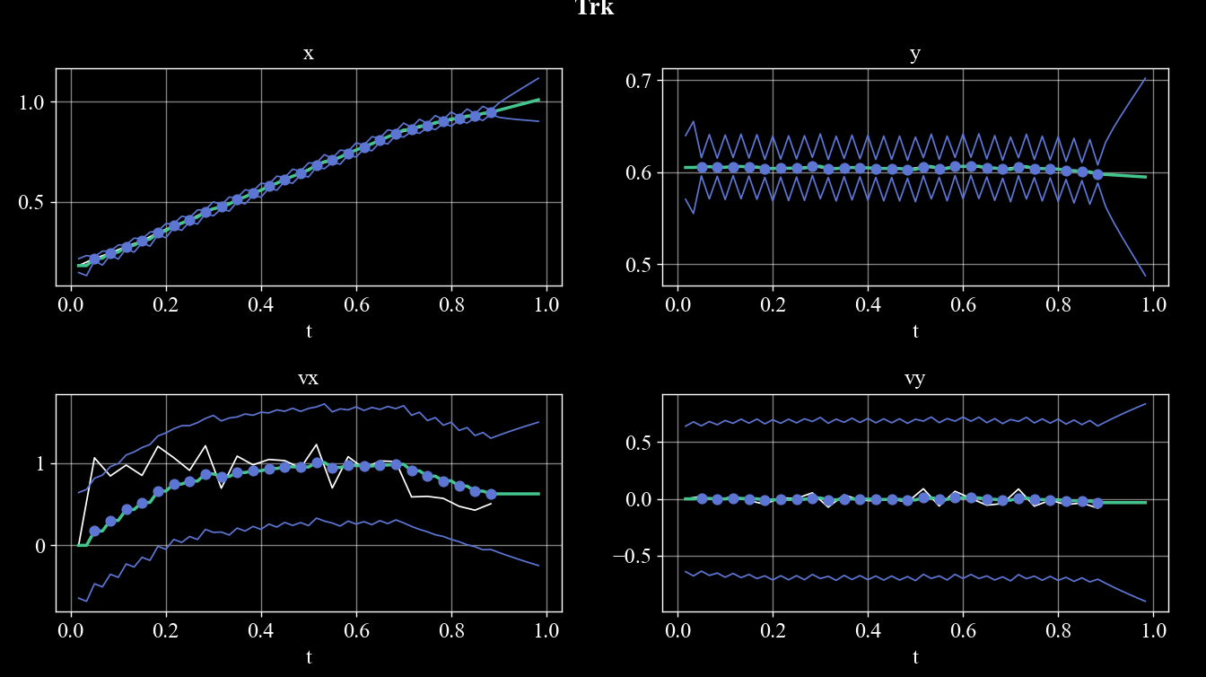
P 0.0001, 0.0001, 0.36, 0.36, x0= ptx, pty, 0, 0
Q 0.001, 0.001, 0.05, 0.05, R 0.0001, 0.0001,

Slide 12
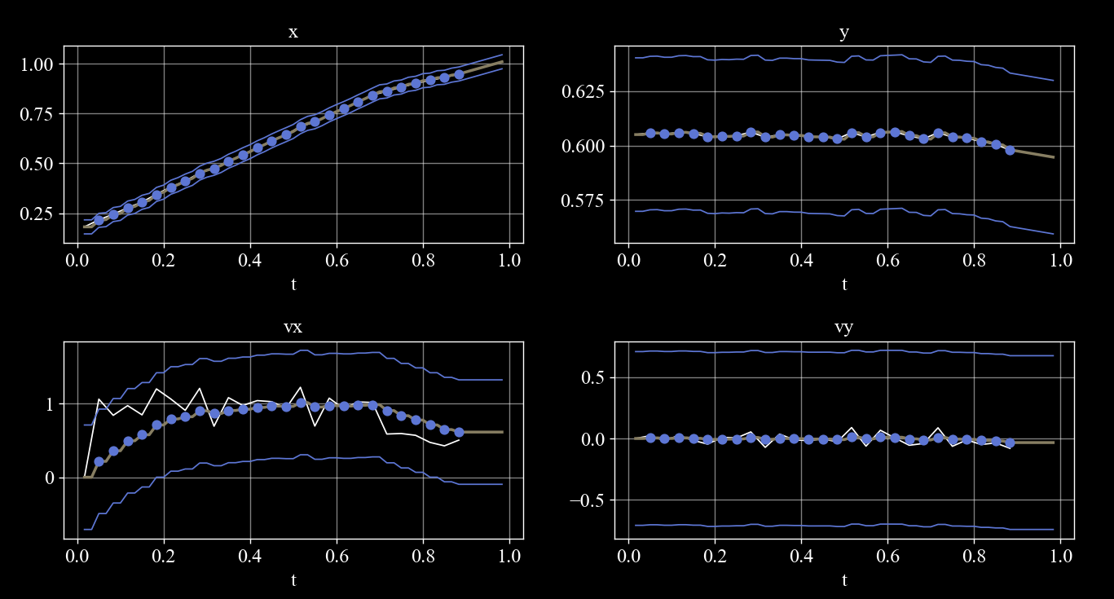
Stedaystate kalman, x0= ptx, pty, 0, 0
Q 0.001, 0.001, 0.05, 0.05, R 0.0001, 0.0001,

Slide 13
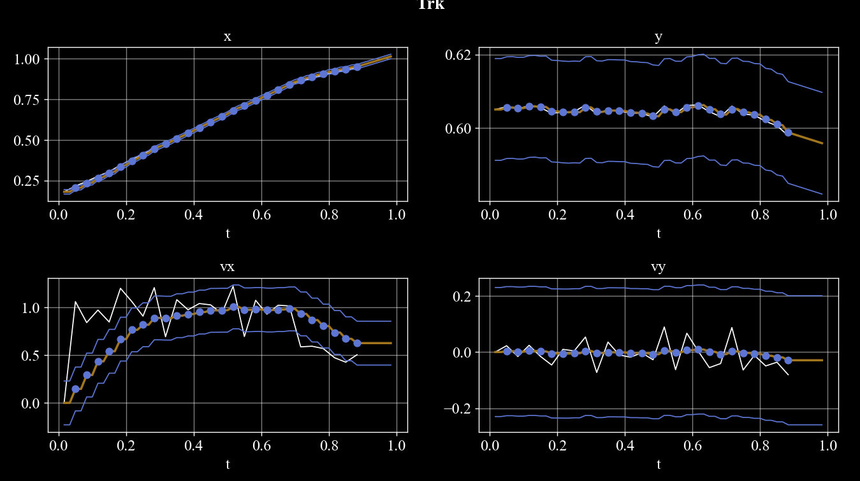
Stedaystate kalman, x0= ptx, pty, 0, 0
Q 0.0001, 0.0001, 0.005, 0.005, R 0.0001, 0.0001,

Slide 14
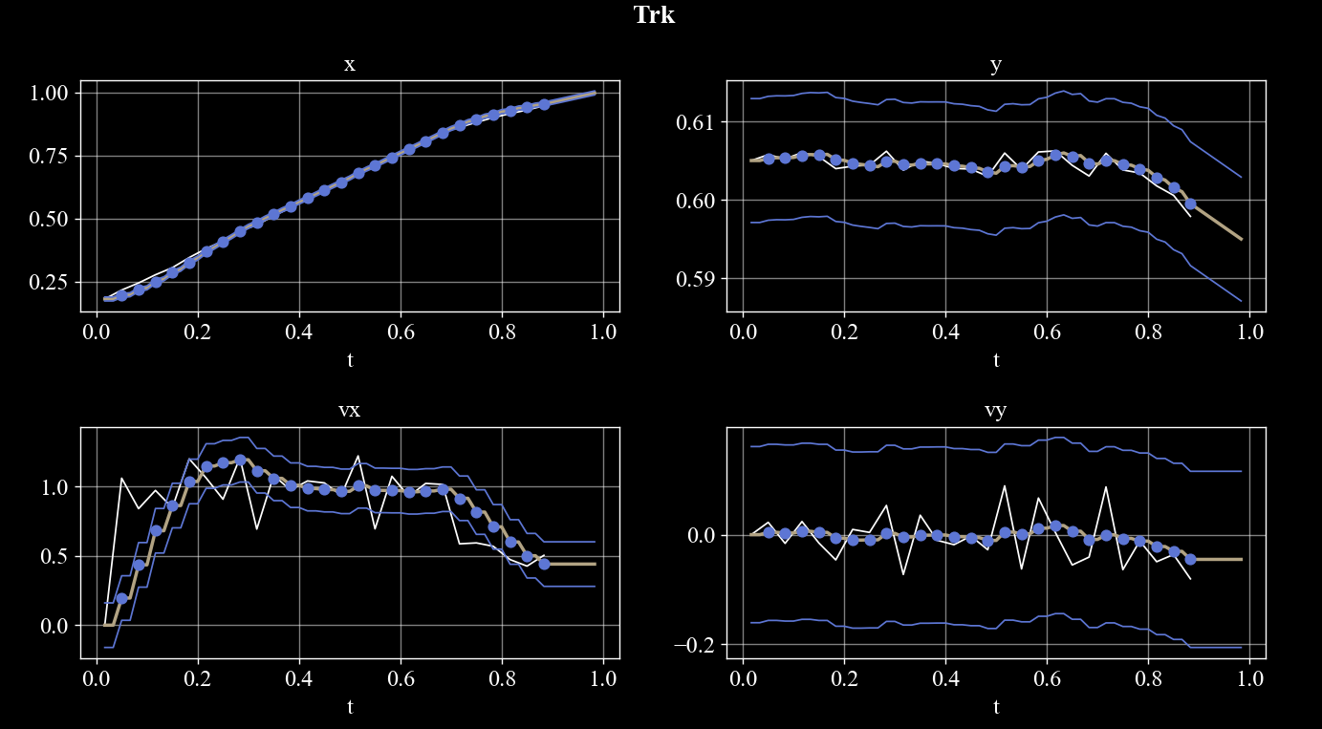
Stedaystate kalman, x0= ptx, pty, 0, 0
Q 0, 0, 0.005, 0.005, R 0.0001, 0.0001,

Slide 15
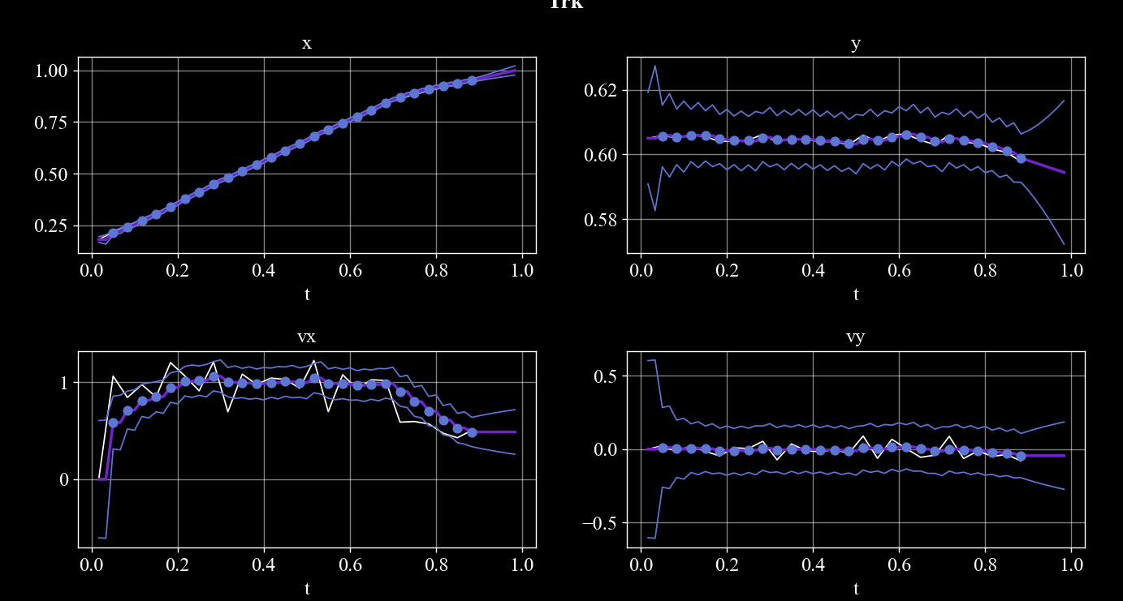
P0=.0001, .0001, .36,.36, x0= ptx, pty, 0, 0
Q 0, 0, 0.005, 0.005, R 0.0001, 0.0001,

Slide 16
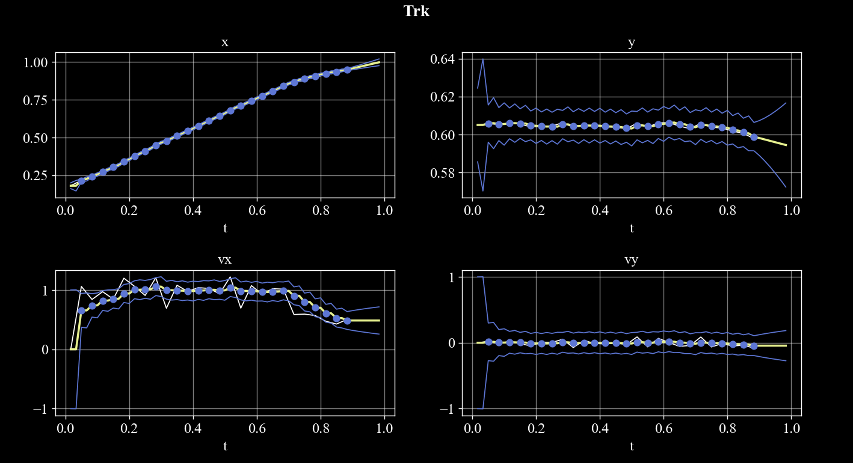
P0=.0001, .0001, 1, 1, x0= ptx, pty, 0, 0
Q 0, 0, 0.005, 0.005, R 0.0001, 0.0001,

Slide 18
V

Slide 19
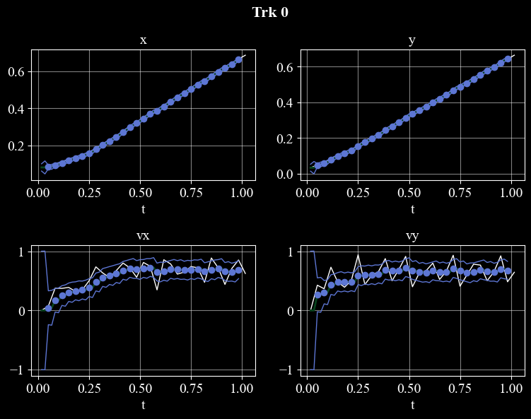
P 0.0001, 0.0001, 1.0, 1.0,
Q 0.0, 0.0, 0.005, 0.005,
R 0.0001, 0.0001,

Slide 20
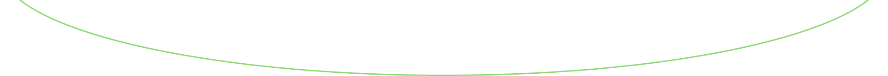
x²
V

Slide 21
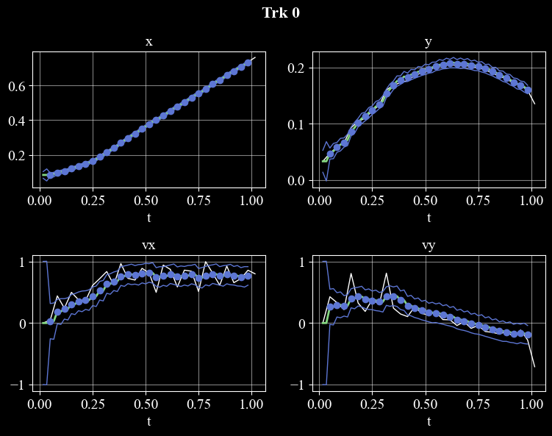

Slide 22
Because 3 planes had objects merging I changed the model to include also width and height.
Now cars1 is bad and the bboxes maintain fixed size result in smaller than needed when arrive at the bottom edge.
So there probabely should be multiple choise for system dynamics, beyond just linear\nonlinear but also fixed size bboxes\ varying size.
Maybe also to make many presets of noise matrices. To suggest it on the project website and to add an option, sth like – don’t u know what model to select? Try our AI selector with low prise for..
As For the website, take impression from the

Slide 23
Constant acceleration

Slide 24

The system
Assuming linear motion (constant acceleration)
$\dot{x}=v$
$\dot{v}=a$
$\dot{a}=0$
Notes:
Post 1: why ekf? The difference between linear and nonlinear.
What’s the punch?
None of the following systems could be developed: ..
Missile guidance, satellite navigation, autonomous driving, and much more could not have been developed without the support of extended Kalman filter estimation.
While the Kalman filter excels in linear systems, the EKF boldly extends its prowess to tackle the complexities of nonlinear systems, making it a dynamic force in modern estimation algorithms

Slide 25


Kalman process
Predict equations
$x=x+A⋅x⋅dt$
$P=F⋅P⋅F^{T}+Q_{k}$
$A=\left[\begin{matrix}0 & 0 & v_{x} & 0 \\ 0 & 0 & 0 & v_{y} \\ 0 & 0 & 0 & 0 \\ 0 & 0 & 0 & 0\end{matrix}\right]$
$F=I+A⋅dt$
$diag\left(Q\right)=\left[\begin{matrix}φ_{v} & φ_{v} & φ_{v} & φ_{v}\end{matrix}\right]$
$Q_{k}=Q⋅dt$
State
$X=\left[\begin{matrix}x & y & v_{x} & v_{y} & a_{x} & a_{y}\end{matrix}\right]$
$x, y$ position
$v_{x}, v_{y}$ velocity
$a_{x},a_{y}$ acceleration
Dynamics
$\dot{x}=v_{x}$
$\dot{y}=v_{y}$
${\dot{v}}_{x}=a_{x}$
${\dot{v}}_{y}=a_{y}$
$X_{0}={\left[\begin{matrix}x_{0} & y_{0} & v_{x_{0}} & v_{y_{0}} & & \end{matrix}\right]}^{T}$
$diag(P_{0})=\left[\begin{matrix}σ_{k}^{2} & σ_{k}^{2} & {v_{x}}_{err}^{2} & {v_{y}}_{err}^{2} & & \end{matrix}\right]$
Noise
Velocity uncertainty $σ_{v}=φ_{v}$
Notes:
The nonlinear part of the filter is manifested in the dynamic equations. These include the height velocity derivative which when expressed in terms of the ballistic coefficient $β$ is a nonlinear function of the height position $z$, the height velocity $v_{z}$, and the ballistic coefficient $β$ itself.
When the process noise matrix $Q$ is time-varying, you can provide the predict function with it at each call.

Slide 26
Kalman measure
Update equations
$k={P⋅H^{T}⋅\left(H⋅P⋅H^{T}+R_{k}\right)}^{−1}$
$x=x+k⋅(Z−H⋅x)$
$P=\left(I−k⋅H\right)⋅P$
$H=\left[\begin{matrix}1 & 0 & 0 & 0 \\ 0 & 0 & 1 & 0\end{matrix}\right]$
$R_{k}=\left[\begin{matrix}σ_{k}^{2} & 0 \\ 0 & σ_{k}^{2}\end{matrix}\right]$
Sensor
YOLOv3
Objects detection model
$Z=\left[\begin{matrix}x & y\end{matrix}\right]$
Noise
Measurement variance $σ_{k}^{2}$
Rate
$\frac{1}{30}msec$
Notes:
The nonlinearity may be manifested in different ways.
The system equations and the measure equations must be linearized even for the case of the extended Kalman filter, for the calculations of P and k. but as opposed to the regular Kalman filter, they are not linearized once about an equilibrium state, but rather they are linearized at each step about the estimated state.
In fact not always both the process equations and the measure equations are both nonlinear, and there may be mixed situations, i.e. either the process equations nonlinear or the measure equations nonlinear. But if both the process equations are linear and the measure equations are linear, then the selection in extended klaman filter is basically a missunderstandning, and the effort to calculate the linearized matrices at each step is total useless.
transition matrix F and the measure must be linearized for the calculation of P at the predict stage.
If the system equations are nonlinear, then the transition matrix F is linearized about the current estimated step at each step.
But

